Slide 1
Digital ic tester
Group no.4
Group members:
1)Himanshu pandey(20)
2)Nishant bhat(41)
3)Shyam kawale(27)
4)Abhijit gawai(18)
5)Bhargav pawar(46)

Slide 2
Need for project
Different IC’s come with different specifications. Thus it becomes imperative to apply different hardware configurations and feed all possible inputs for checking different IC’s.
We need some easy and different techniques to check the functionality of different kind of IC’s.
Unlike the IC testers available in the market, ours is user friendly and affordable.

Slide 3
Hardware
Bread Board
Male to male jumper wires
LED’s
Integrated Circuits(7486,7432,7408)

Slide 4
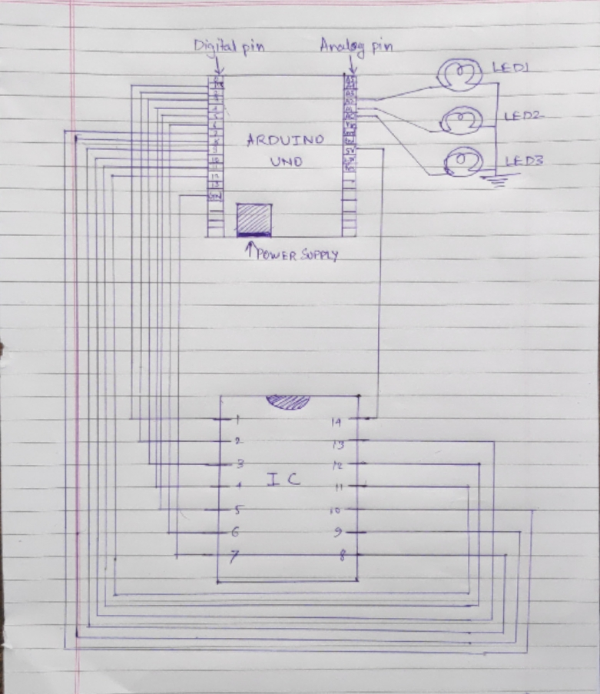

Slide 5
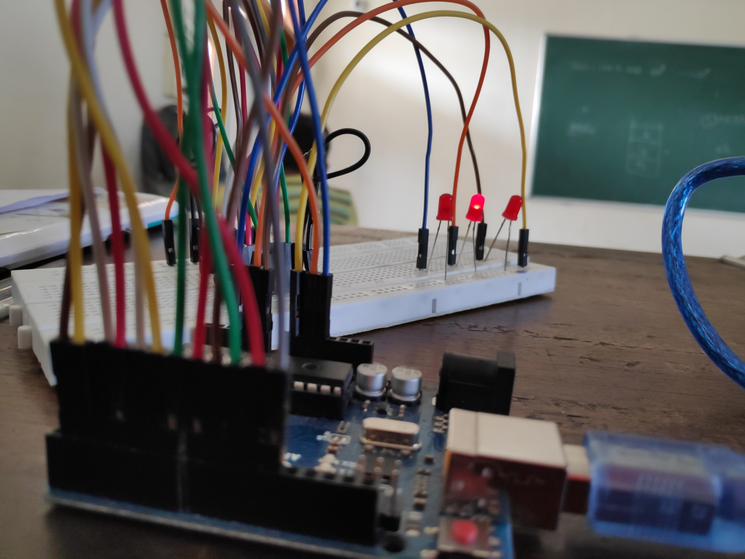

Slide 6
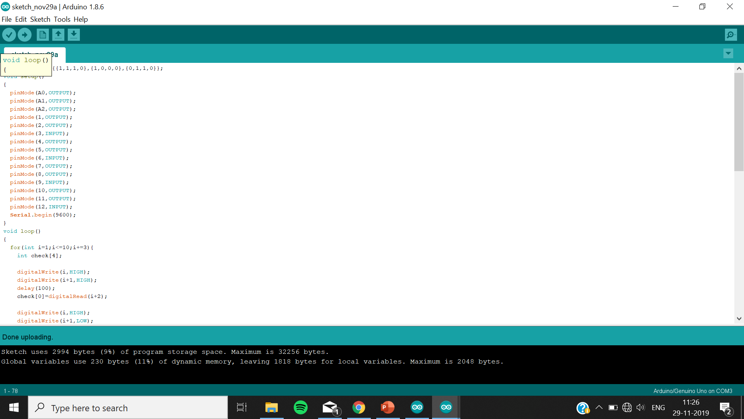
Source code

Slide 7
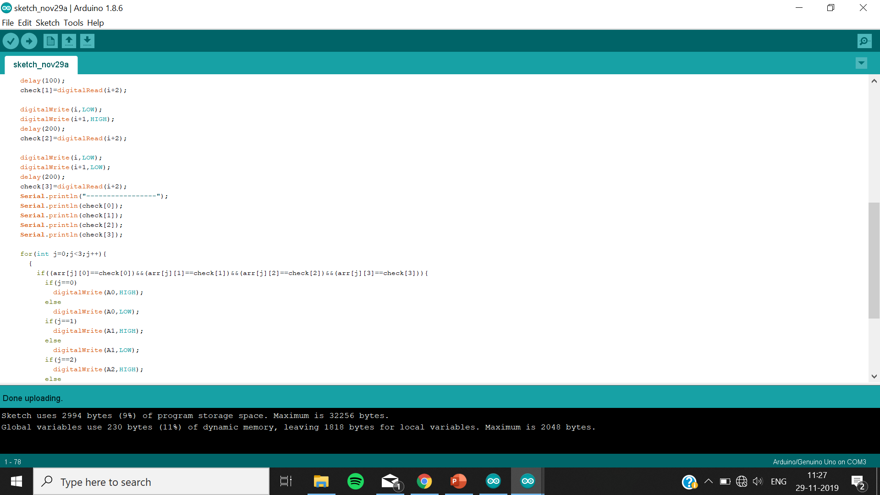

Slide 8
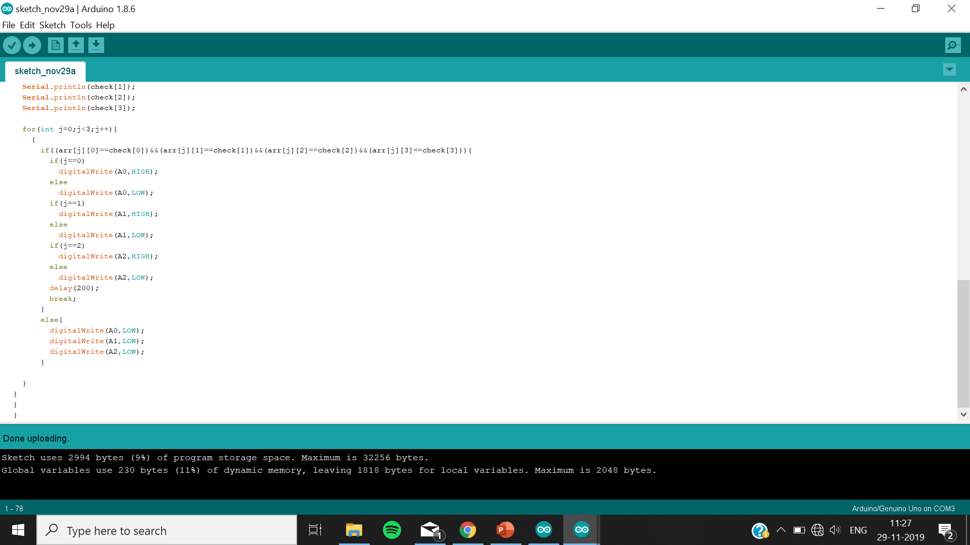

Slide 9
applications
This IC tester can be used to test a wide variety of ICs which includes simple logic gates and also sequential and combinational ICs like flip-flops, counters, shift registers etc. It is portable and easy to use.
The type of IC is also identified.

Slide 10
Conclusion
In this way IC’s can be tested that they are working or not.
Now worn out and old IC’s can be detected and used accordingly.

Slide 11
Thank you.

